Slide 1
Climate Change Belief Analysis

Slide 2

Introduction
Problem Statement
Exploratory Data Analysis
Data Engineering
Model Exploration
Conclusion

Slide 3
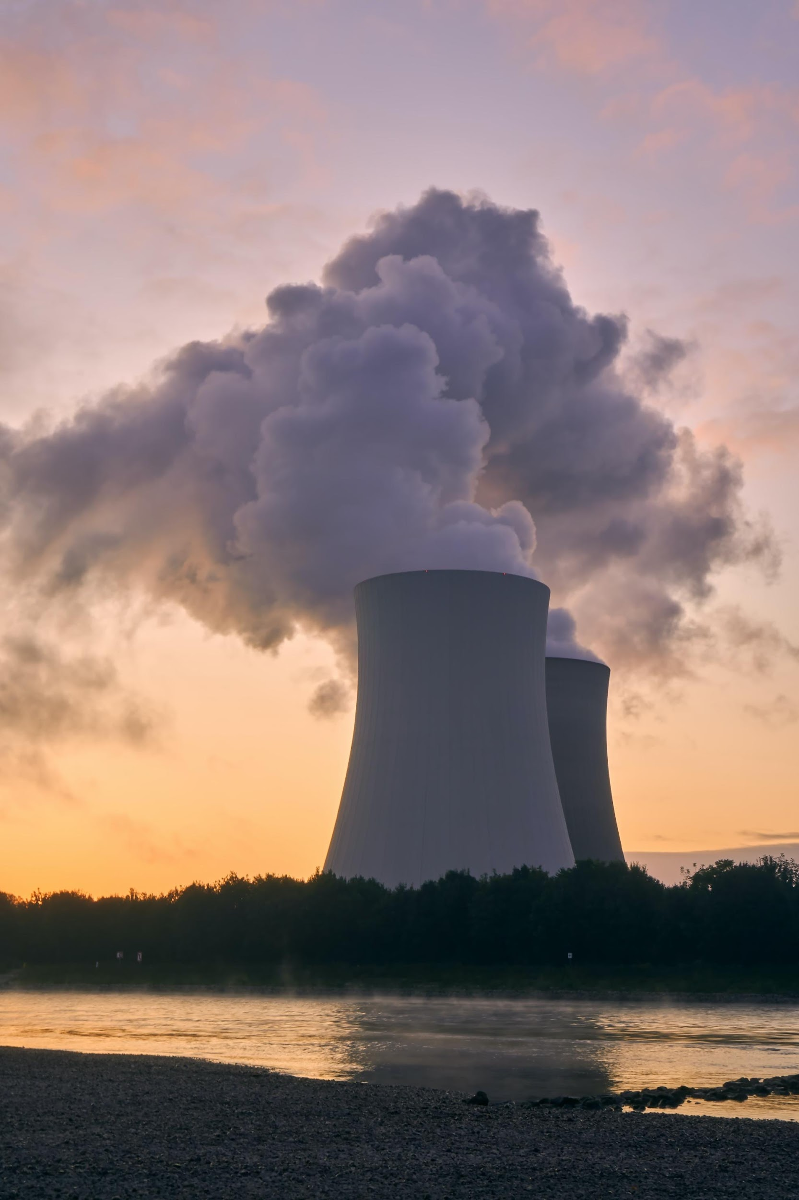
1. Introduction
Climate change is a complex problem with impacts and interactions at global to local scales.

Slide 4

2. Problem Statement
Humans are striving for environmental friendliness and sustainability.
Beliefs in climate change vary significantly.
Develop a machine learning model to categorize human beliefs on climate change based on their unique tweet data.
Notes:
The process of detecting positive or negative sentiment in text is known as sentiment analysis. Businesses use it to detect sentiment in social data, assess brand reputation, and gain a better understanding of their customers (adashofdata, 2020).

Slide 5
3. Exploratory Data Analysis
EDA was crucial to performing initial investigations on the dataset.
This exposed patterns, anomalies and generalized assumptions on the dataset.

Slide 6
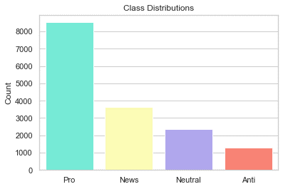
Class Distributions and Sentiment Analysis
Sentiment | Value Count | %
1(pro) | 8530 | 53.92
2(news) | 3640 | 23.01
0(neutral) | 2353 | 14.87
-1(anti) | 1296 | 8.19
Notes:
Class Description * 2 News: the tweet links to factual news about climate change * 1 Pro: the tweet supports the belief of man-made climate change * 0 Neutral: the tweet neither supports nor refutes the belief of man-made climate change * -1 Anti: the tweet does not believe in man-made climate change
The distribution of sentiment classes is unbalanced, as shown in the dataframe comparing the value counts and percentages of each sentiment class, because the classes do not have the same number of tweets.

Slide 7
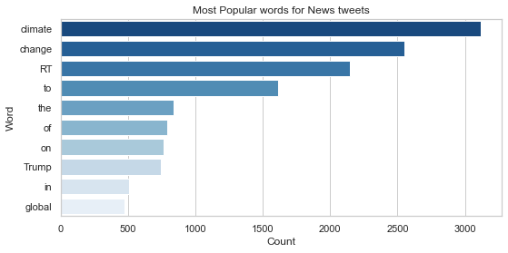
Notes:
Sentiment analysis assists businesses in making decisions. For example, if public opinion of a product is negative, a company may attempt to modify the product or stop production in order to maintain competitiveness.

Slide 8
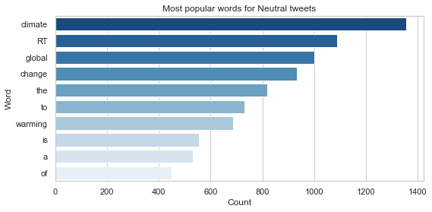

Slide 9
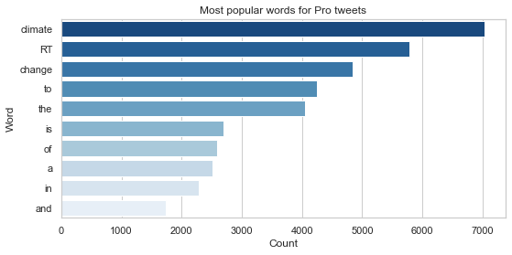

Slide 10
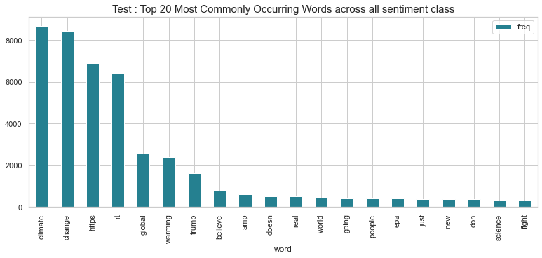

Slide 11
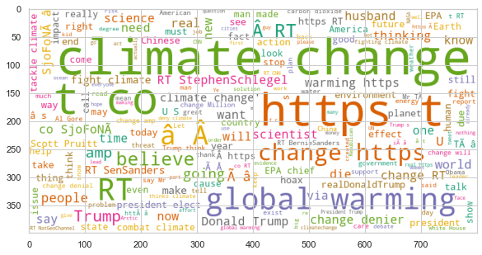
Sentimental Buzzwords
Notes:
Wordclouds are excellent tools for visualizing specific word popularity per class and exposing buzzwords (popular terms that are frequently used by people who discuss the climate change topic).

Slide 12
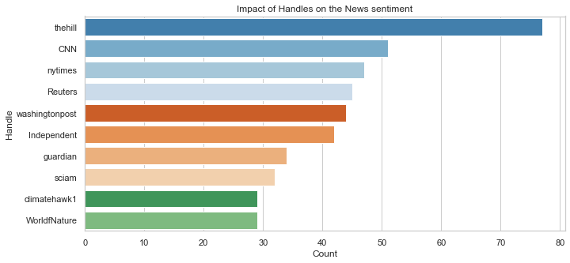
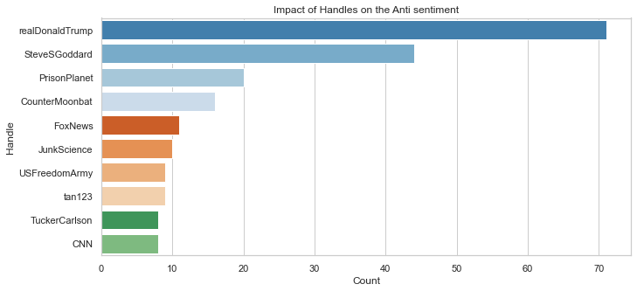
The Influence of Twitter Handles on Sentiment Classes
Notes:
Observations:
The most popular News handles are those of actual news broadcasters. The hill is the most popular twitter handle discussing climate change.
Celebrity and news accounts appear to be the most popular Pro handles. Stephenschiegel is the most well-known professional on climate change.
Trump has the most popular anti- and neutral tweets.
The most popular trends handles are American, as 76.9 percent of Twitter users live in the United States of America.
It's worth noting that Fox News isn't mentioned in the positive sentiment. The company is frequently scrutinized by the public because it is perceived to support Republican policies in the United States of America.

Slide 13
Summary Overview
Climate Change and Global Warming are the most popular words in all four classes.
Noise words, such as http, https, website, co, and RT, reoccurred
Same top five words in each class. An exception of the News class, where the word ‘Trump’ appears prominently.

Slide 14

4. Data Engineering
The process involved NLP techniques on;
Noise Removal
Tokenization
Removing Stop words
Stemming
Lemmatization
Duplicate check

Slide 15

5. Model Exploration
Built a Pipeline for the preprocessor and selected a base model.
The following slide shows how different models performed.

Slide 16
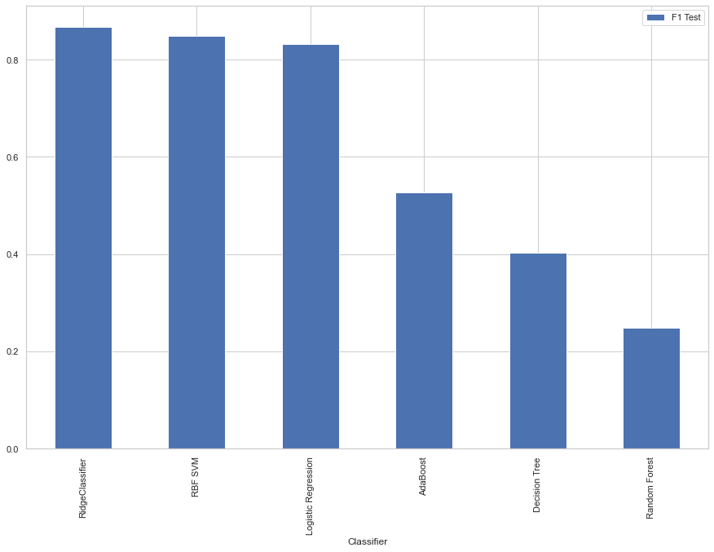
F1 Test Scores
Notes:
The F-measure, often known as the F-score, is a measurement of a test's accuracy used in statistical analyses of binary categorization.
The F1 score is the harmonic mean of the precision and recall

Slide 17
Conclusion and The Big concept
Human sentiments take a variety of demographic and geographic categories.
Our model stands out in precision and diversity on insights that will guide future decisions on climate change.

Slide 18
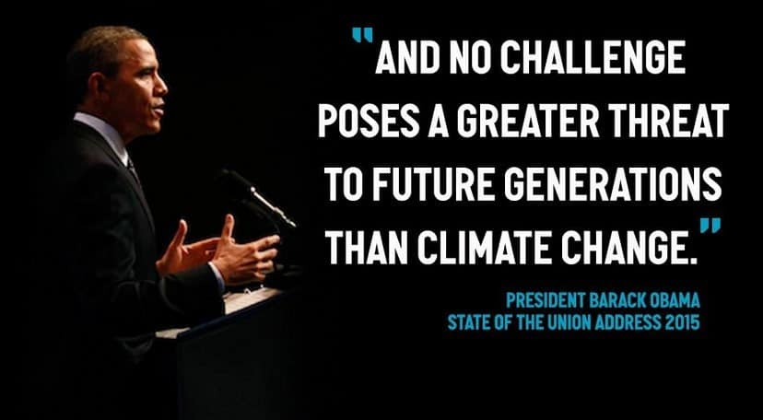

Slide 19

Thank You!
Any questions?

